Slide 1
CPSC3300: Computer Systems Organization
Lecture 12 – Pipeline Hazards

Slide 2
Pipelining and ISA Design
MIPS ISA designed for pipelining
All instructions are 32-bits
Easier to fetch and decode in one cycle
c.f. x86: 1- to 17-byte instructions
Few and regular instruction formats
Can decode and read registers in one step
Load/store addressing
Can calculate address in 3rd stage, access memory in 4th stage
Alignment of memory operands
Memory access takes only one cycle

Slide 3
Hazards
Situations that prevent starting the next instruction in the next cycle
Structure hazards
A required resource is busy
Data hazard
Need to wait for previous instruction to complete its data read/write
DAG is used to identify data dependencies
Control hazard
Deciding on control action depends on previous instruction

Slide 4
Structure Hazards
Conflict for use of a resource
In MIPS pipeline with a single memory
Load/store requires data access
Instruction fetch would have to stall for that cycle
Would cause a pipeline “bubble”
Hence, pipelined datapaths require separate instruction/data memories
Or separate instruction/data caches

Slide 5
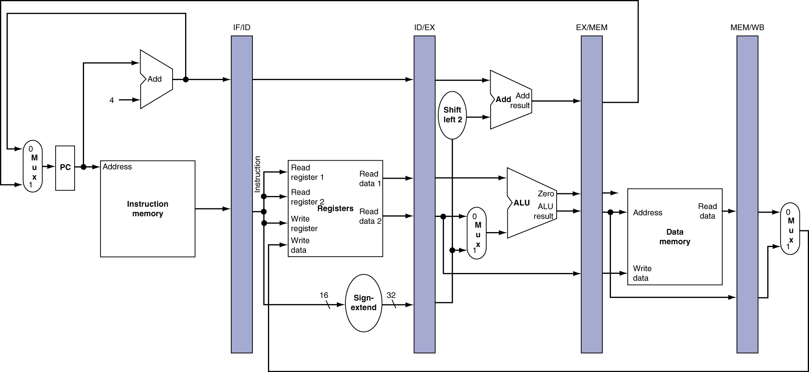
Structure Hazard
In addition to IM and DM, what other structures (hardware) are duplicated to resolve structure hazard?

Slide 6
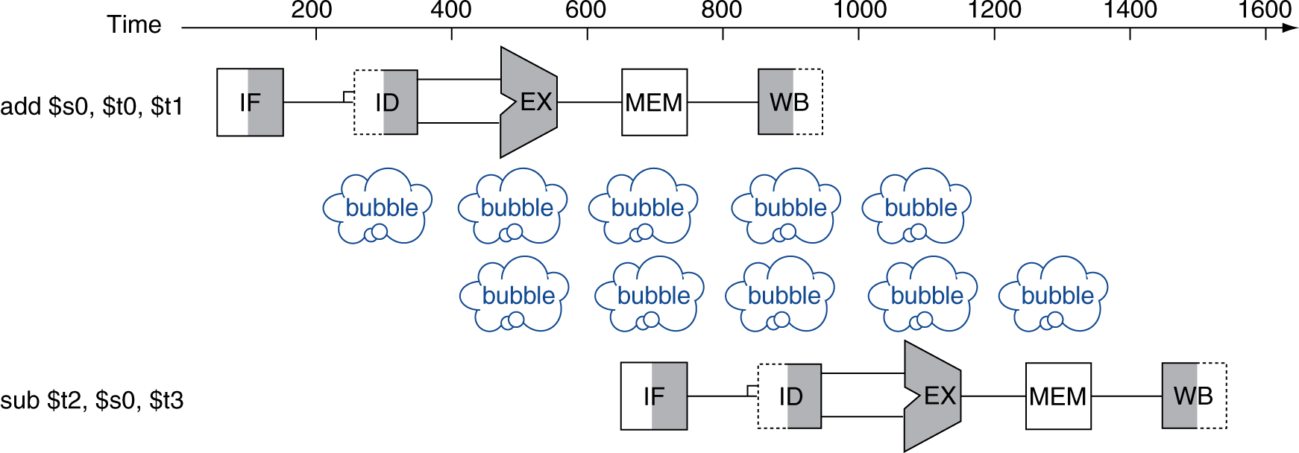
Data Hazards
An instruction depends on completion of data access by a previous instruction
True dependence in MIPS: RAW
add $s0, $t0, $t1 sub $t2, $s0, $t3
Simple solution:
stall the pipeline by inserting NO-OP (0x00000000)
Instruction exec. delayed, performance poor

Slide 7
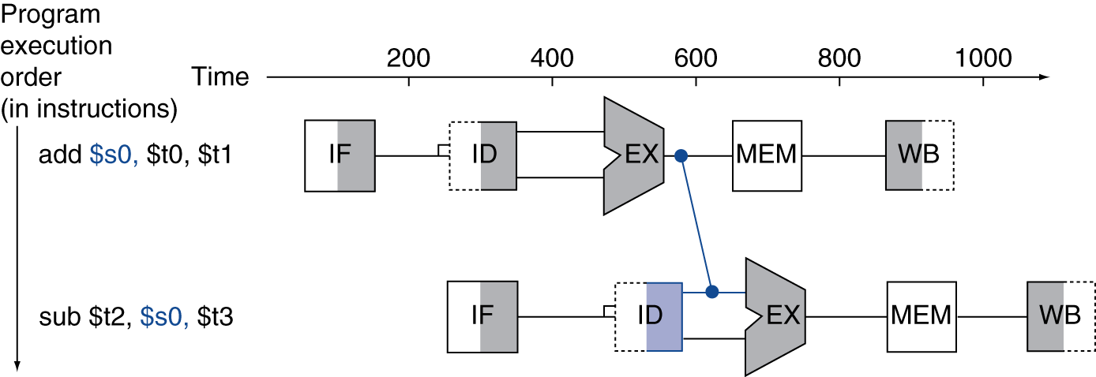
Forwarding (aka Bypassing)
Better solution: use result when it is computed
Don’t wait for it to be stored in a register
Requires extra connections in the datapath
Extra connection

Slide 8
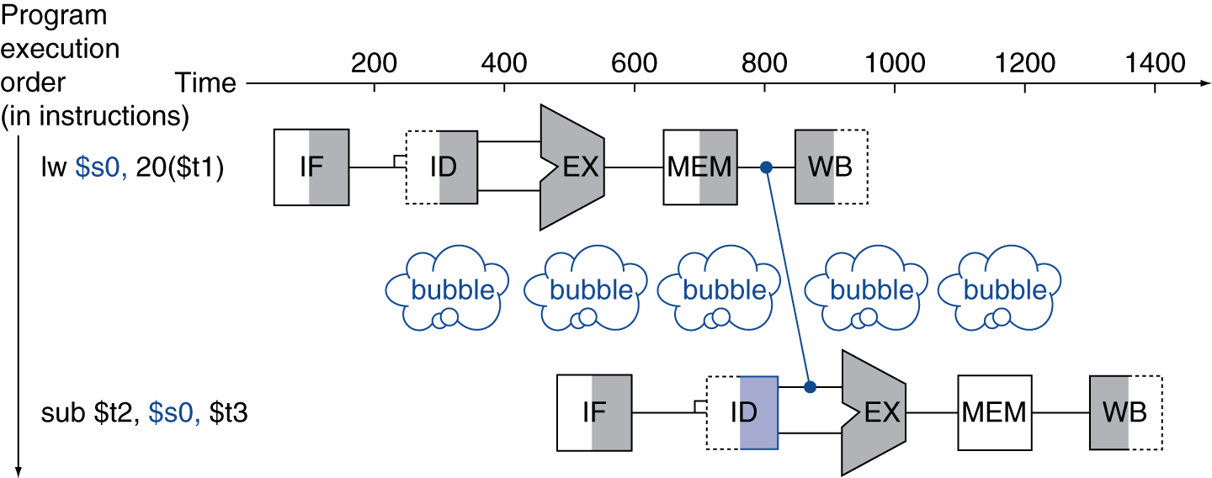
Load-Use Data Hazard
Forwarding can’t always avoid stalls by forwarding
If value not computed when needed
Can’t forward backward in time!
If the previous instruction is lw, a bubble must be inserted in addition to forwarding
Forwarding +
stall

Slide 9
Code Scheduling to Avoid Stalls
Reorder code to avoid use of load result in the next instruction
C code for A = B + E; C = B + F; Operands in memory
lw $t1, 0($t0)
lw $t2, 4($t0)
add $t3, $t1, $t2
sw $t3, 12($t0)
lw $t4, 8($t0)
add $t5, $t1, $t4
sw $t5, 16($t0)
lw $t1, 0($t0)
lw $t2, 4($t0)
lw $t4, 8($t0)
add $t3, $t1, $t2
sw $t3, 12($t0)
add $t5, $t1, $t4
sw $t5, 16($t0)
stall
stall
13 cycles
11 cycles
Whose job is it?
Compiler should do the scheduling, but it is increasingly implemented in hardware.

Slide 10
Stalls and Performance
Stalls reduce performance
But are required to get correct results
We have learned
Structure hazard: duplicated/separated hardware to resolve it
Data hazard: detection by examining dependencies, and forwarding to reduce its impact
How about control hazard?

Slide 11
Control Hazards
Branch determines flow of control
Fetching next instruction depends on branch outcome
The following instruction may not be the one to be executed
Pipeline can’t always fetch correct instruction
Still working on ID stage of branch
In MIPS pipeline
Need to compare registers and compute target early in the pipeline
Add hardware to do it in ID stage

Slide 12
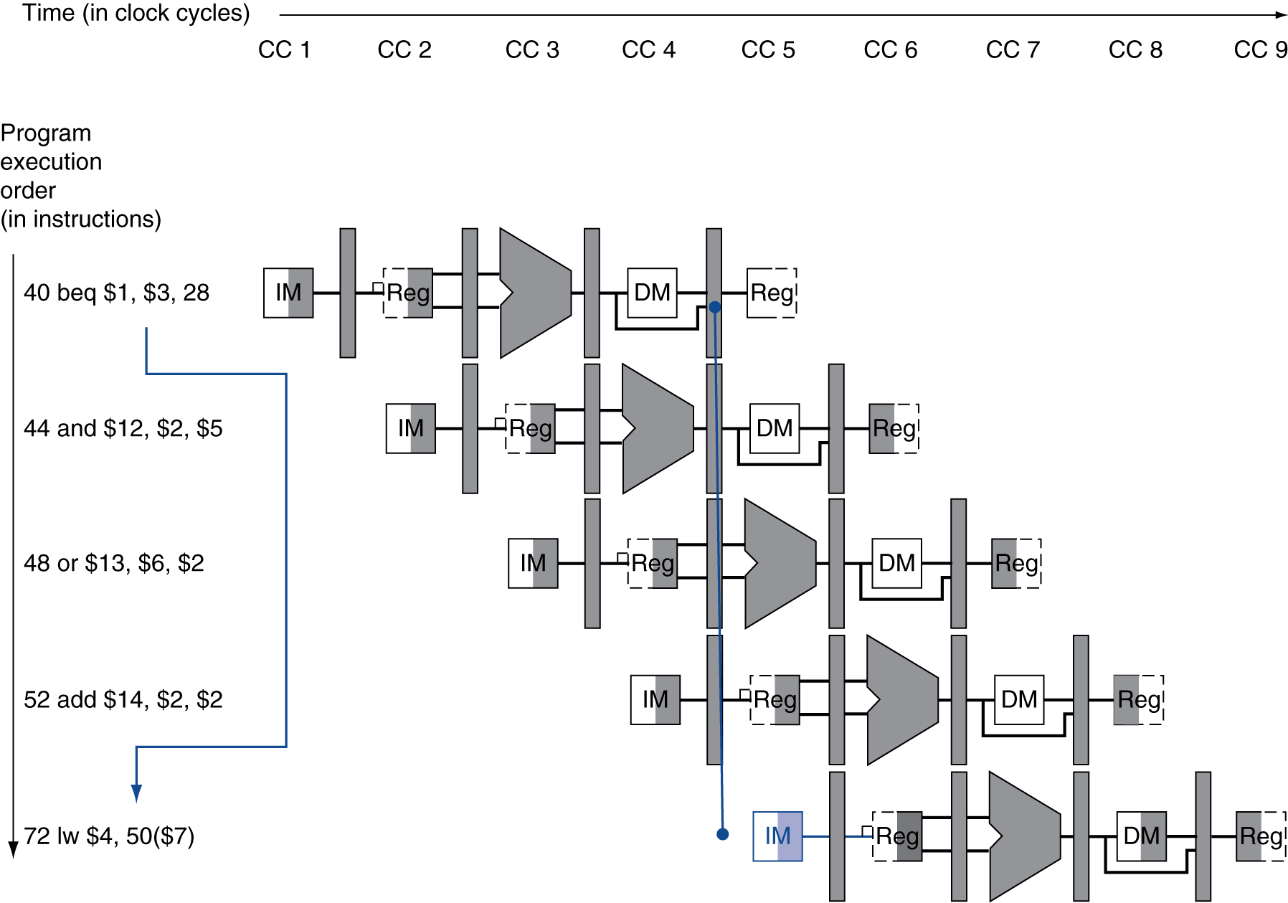
Branch Hazards
If no special treatment on branch instruction,
extra branch outcome determined in MEM
7
Flush these instructions
(Set control values to 0)
PC

Slide 13
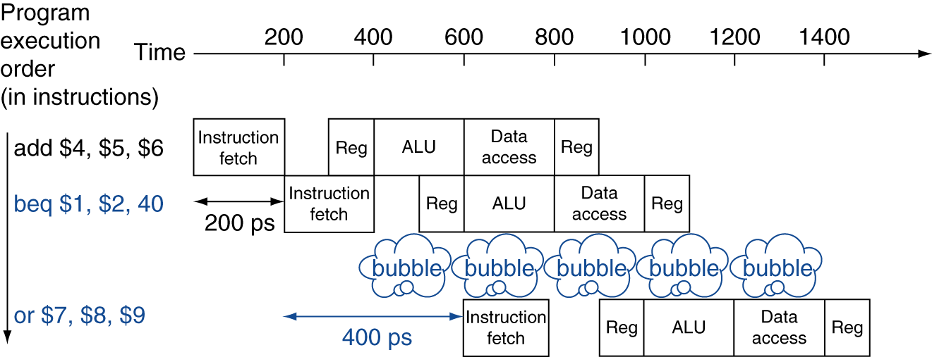
Stall on Branch
Special treatment: execute the target address by the end of the ID stage
Stall the pipeline until branch outcome determined before fetching next instruction
One No-Op inserted
Target address is available after the ID stage

Slide 14
Branch Prediction
Longer pipelines can’t readily determine branch outcome early
Stall penalty becomes unacceptable
Predict outcome of branch
Only stall if prediction is wrong
In MIPS pipeline
Can predict branches not taken
Pipeline executes as normal if prediction is correct
Fetch instruction after branch, with no delay

Slide 15
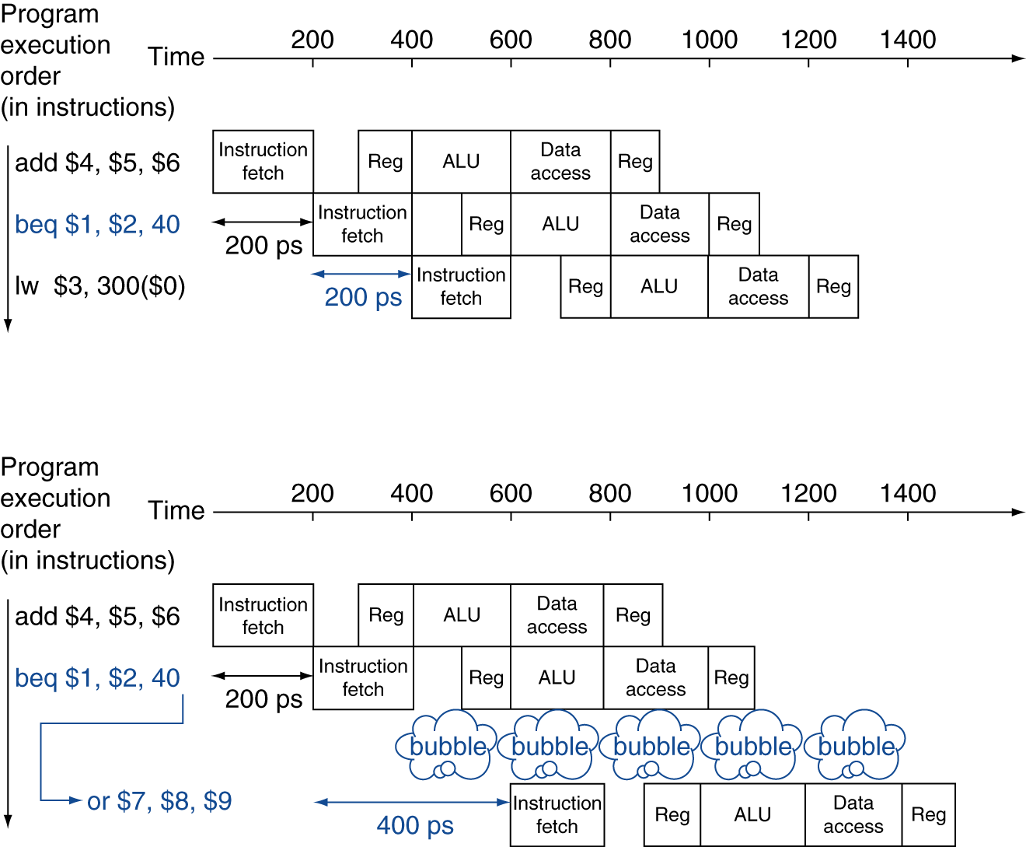
MIPS with Predict Not Taken
Prediction correct
Prediction incorrect

Slide 16
Pipeline Summary
Pipelining improves performance by increasing instruction throughput
Executes multiple instructions in parallel
Each instruction has the same latency
Subject to hazards
Structure, data, control
Instruction set design affects complexity of pipeline implementation
More advanced branch prediction will be introduced next lecture
The BIG Picture
Insights for programmers:
Use branches wisely
Order your instructions wisely

